Slide 1

RefYOUge

Slide 2
“No one chooses to be a refugee. We all deserve to have a home and to be safe.”
—Hangama Amiri

Slide 3
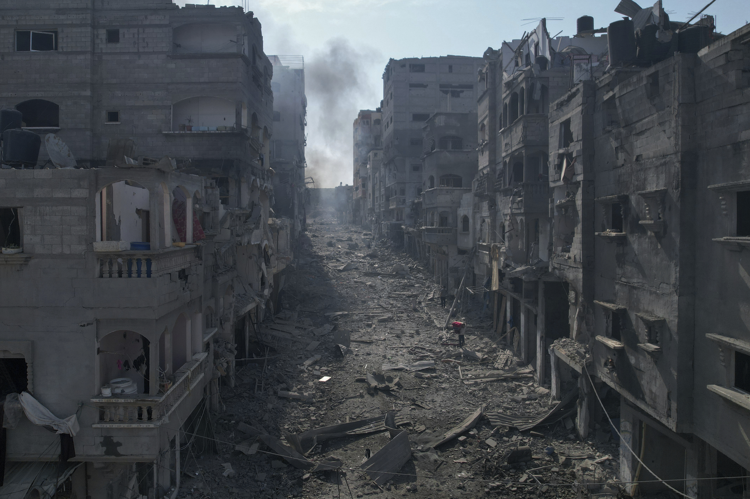
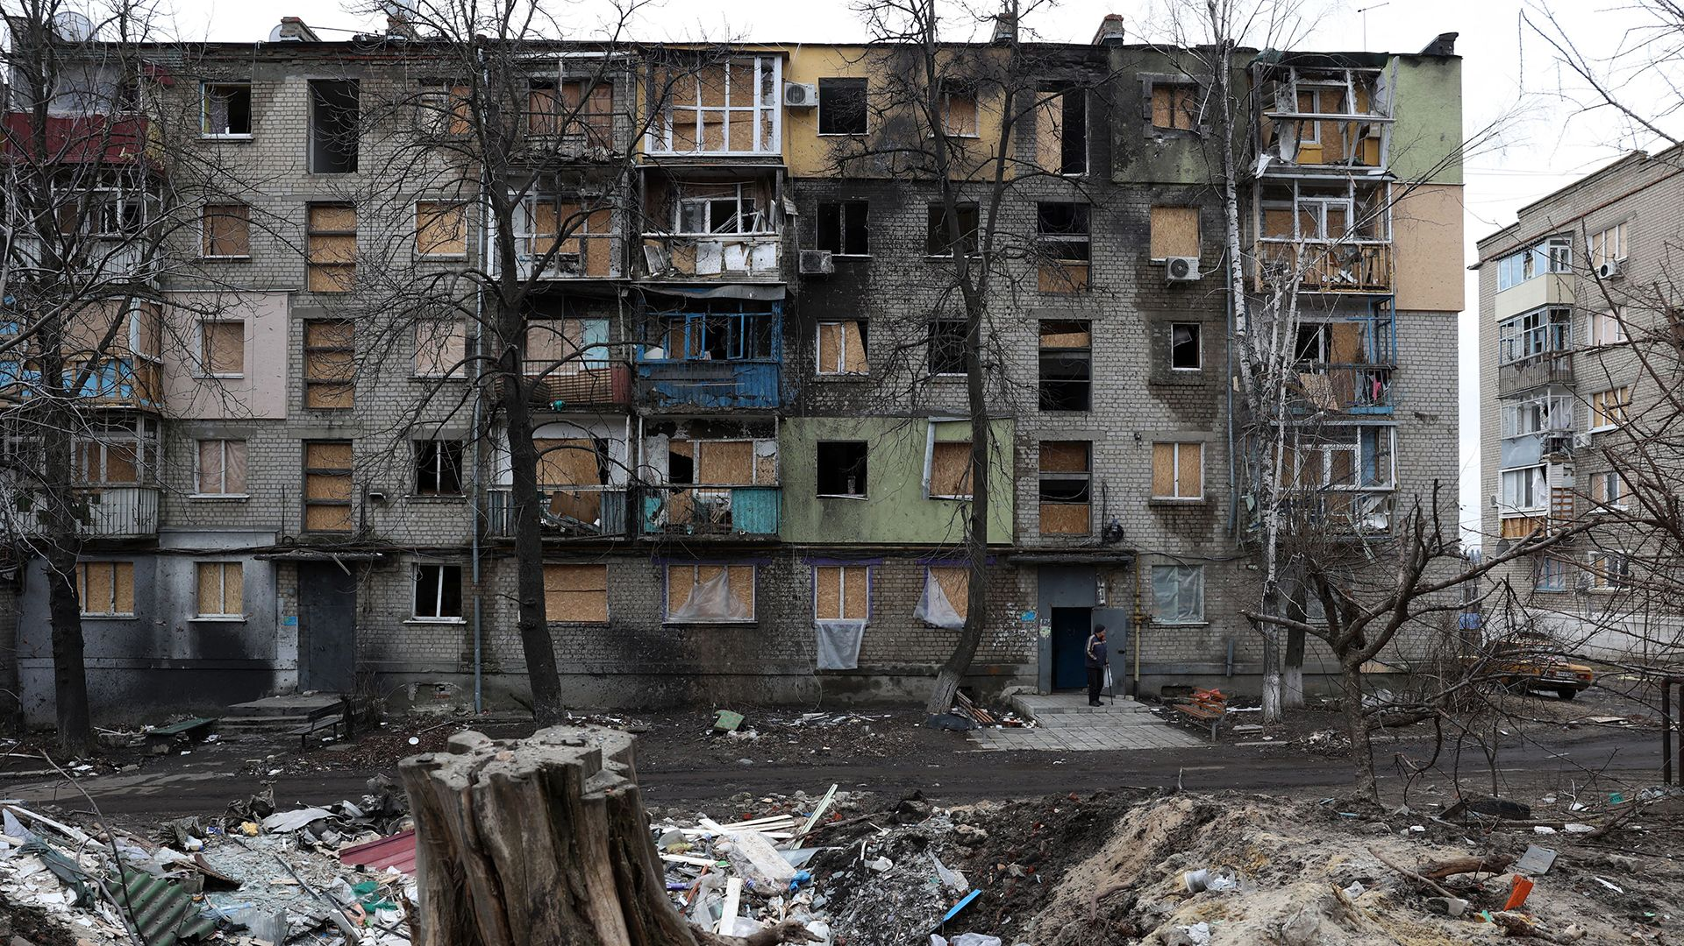
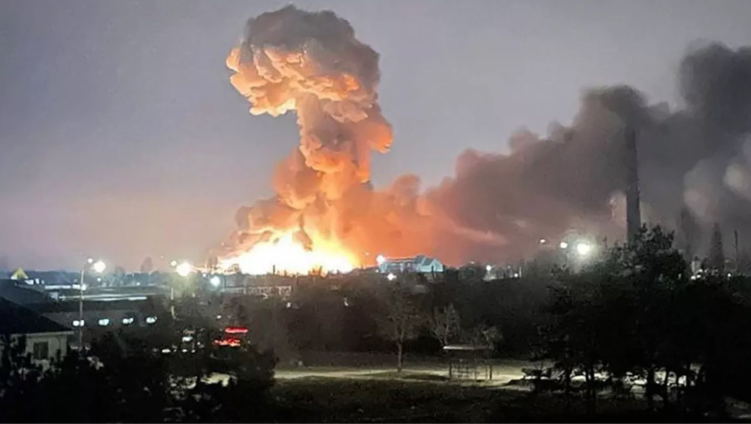
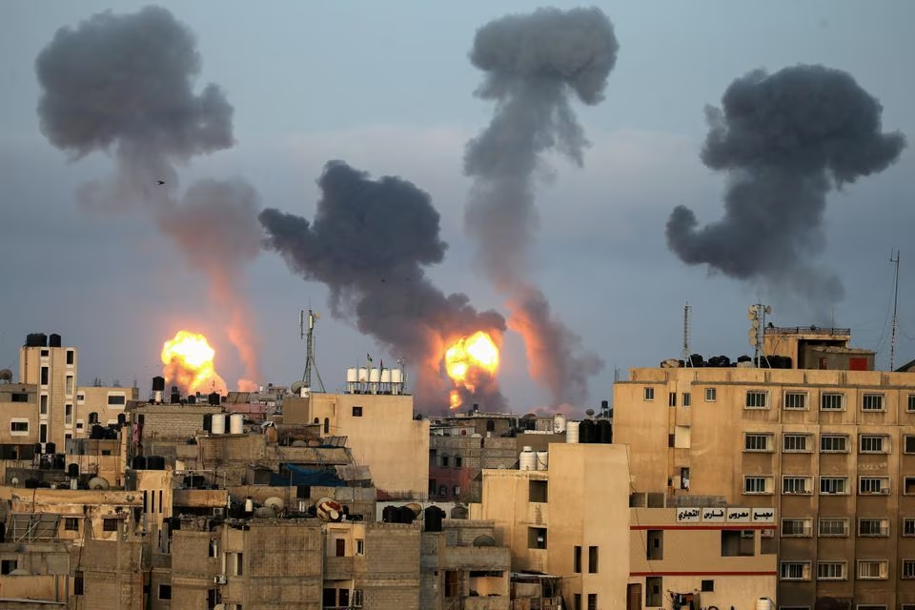
Media
All over the media we have seen terrifying pictures of what people are suffering on a daily basis, in Gaza, Ukraine and others.

Slide 4
Statistics
1.4 million people
5.1 million people
1.8 million people
As of 30th of October more than
In Gaza, were internally displaced.
Internally displaced in Ukraine.
Displaced in Kosovo, during the Kosovo-Serbia war.

Slide 5

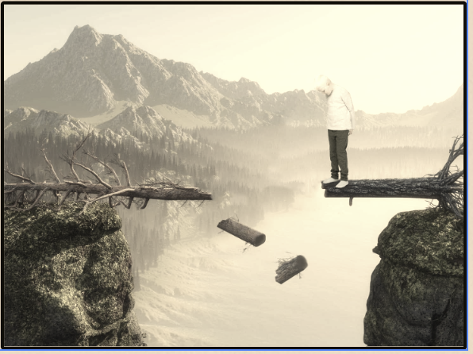

THE CHALLENGE : RECOGNITION OF THE NON-UK QUALIFICATIONS
Understanding the Impact of Non-recognition of Refugee Qualifications
Refugees face challenges in having their qualifications recognized in host countries.
Refugees' valuable skills and expertise go unrecognized, leading to a loss of human capital.
Limited Opportunities
Obstacles to Recognition
Loss of Skills

Slide 6



SUCCESS STORIES: REAL-LIFE EXAMPLES OF THE WEBSITE IN ACTION
Impactful Outcomes of the Refugee Qualification recognitions Website
Economy growth
Well being
Return home

Slide 7
refYOUge
The GOAL of refYOUge is to facilitate the official recognition of refugees' qualifications in the UK by assessing their skills and credentials. This process aims to empower refugees, making them valuable assets for the UK economy. Additionally, our mission is to help refugees achieve a standard of living that aligns with the expectations in the UK or their host country.

Slide 8
Solution Overview
platform serves as a bridge, connecting refugees with job opportunities and tailored skill development programs.

Slide 9
Any Questions?

